Slide 1
Unconscious Bias: Self-improvement through awareness
Ethics Week
November 6th, 2023
Sean Polreis
www.usask.ca
Notes:
Session for Ethics Week @ St. Paul’s Hospital (Pylypchuk Hall). Contact with Dr. Mary Heilman. She works with the Emmanuel Health Ethics Committee & plan our annual W.F. Mitchell Bioethics SeminarPart I of 2.
45 minutes with 15-minute Q & A.
Focus is on the psychology of unconscious bias & how it can impact the care that healthcare professionals provide.
Below is the description they used for promoting this session.
Unconscious Bias: Self-improvement through awareness This session is an introduction to unconscious bias. It is designed to help develop a clear understanding of what unconscious bias is, as well as raise our awareness & become more comfortable in considering our own personal biases. It is intended to help open the door to further discussions about how unconscious bias can negatively impact our decision-making & relationships with others.

Slide 2
Learning objectives
Describe unconscious bias & explain its biological & socio-cultural origins
Examine how experiences & identities shape our biases
Develop the ability to closely inspect our first impression for bias
Notes:
Goal is to embrace our biases, understand them, & have discussions about them.
This is not about blame or guilt. It’s about understanding, awareness, & improvement. It should be informative, interesting, & fun.

Slide 3
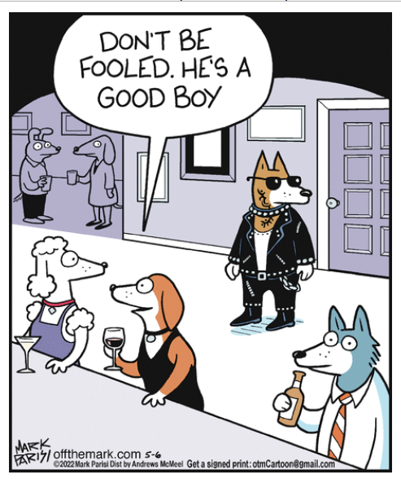
Why important?
Improve decision-making
Positive interactions with others
Fairness
© Andrews McMeel Syndication; Off the Mark by Mark Parisi; 5/6/2022
Notes:
Important for patient care & also for other aspects of our lives.

Slide 4
1st feeling
Happy
Gluttony
Full
Comfort
Coercive
Pleasure
Thrilled
Strong
Charitable
Hungry
Excited
Dangerous
Influential
Privilege
Speedy
Impactful
Powerful
Sad
Joyful
Satisfaction
Disgusted
McDonald’s logo icon courtesy Pixel Icons on IconScout
Notes:
We have stories about people who are like us & people who are not like us (Melissa Crum’s example was Disney movie villains with British accents)
Since they are our stories we have the power to edit them – “biases are the stories we internalize that we create or are created for us” Melissa Crum.
Put up a familiar logo like McDonald’s or Facebook & ask “what do you think of when you see this?” Ask them to write down the first 3 words.
We see an image; we interpret what it means to us; story we hold (i.e. it is simply a blue “f”, a logo, but we all have unique stories about it)
Nobody’s story is “correct” or the only one that’s valid. These associations are our biases.
Bias cannot be eliminated – the objective is to account for it & try to reduce its impact on decisions.

Slide 5
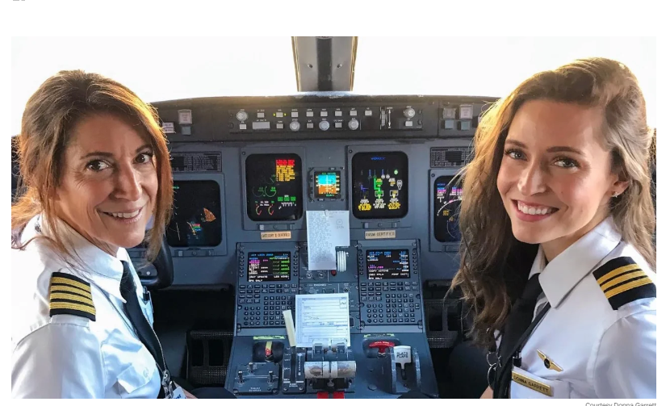
Airlines
Suzy Garrett & Donna Garrett
First mother-daughter pilot pair for SkyWest Airlines
Image courtesy CNN online 11/19/2020
Notes:
Might be the first mother-daughter pair to fly commercial planes – not positive. Industry/profession heavily dominated by white males.
Unconscious biases can even contradict consciously held beliefs.

Slide 6
1) Definition
Notes:
If we were to play word association with the word “bias”, this is what we might find. However, while bias can lead to many of these things, that isn’t how we will define it.

Slide 7
AAMC* Definition
Without intention or control
“Unconscious [everyday] also known as implicit bias, refers to attitudes or stereotypes that are outside our awareness but nonetheless affect out understanding, our interactions, & our decisions.”
Automatic association (pre-reflective)
*Association of American Medical Colleges
Notes:
Quickly describe the difference between explicit/conscious & implicit/unconscious bias (use my sports teams for an example of explicit bias – pro Red Sox; anti Yankees). There are also institutional biases – built into the structure of an organization.
“Everyday” & “implicit” are synonymous with “unconscious” bias.
By themselves, biases are not good or bad or right or wrong – they just “are”. No moral attachment. Egalitarian explicit principles one espouses can live alongside implicit biases that differ.
There are definitions of bias that use the terms “unreasonable”, “hostile”, “opinion”, “prejudice” etc. This is the definition from the AAMC.
There is no intention, awareness, or control. “You will not walk out of here in an hour with less bias”
From Verna Myers TED Talk – “biases are the stories we make up about people before we know who they actually are”.
Bias = pattern recognition/shortcuts. We use this all the time.

Slide 8
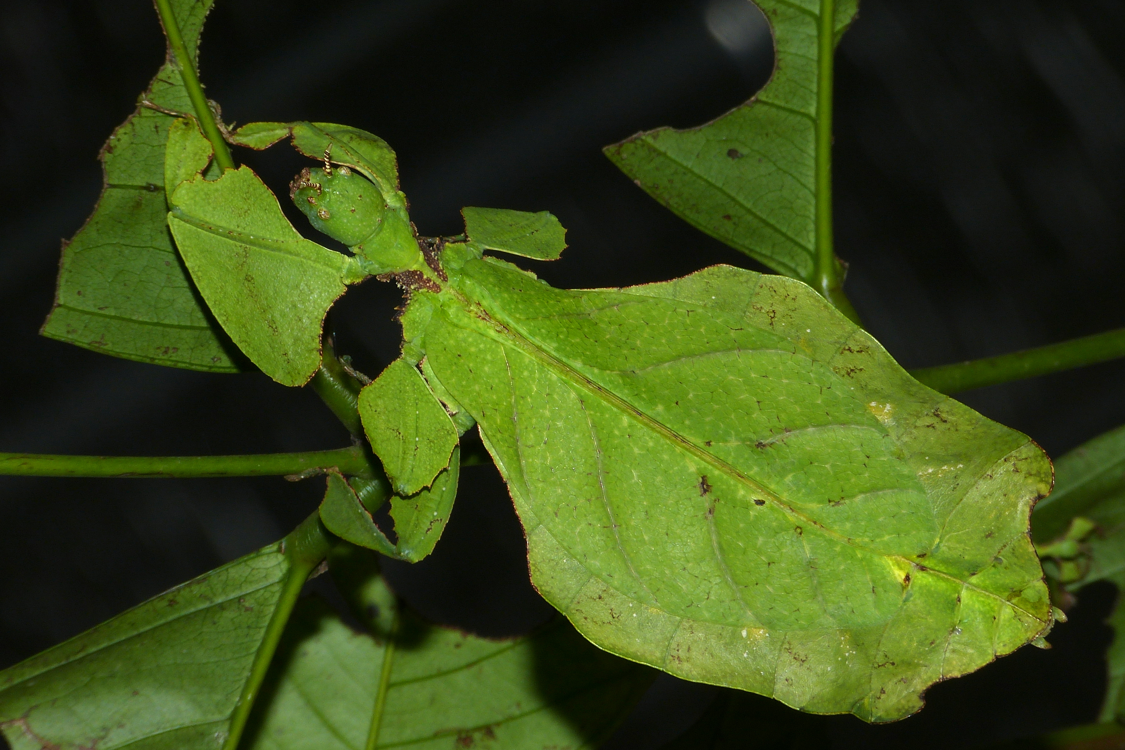
Plants?
Wikimedia Commons
Automatic association or assumption
Notes:
Our automatic associations help us identify things quickly & they are often correct, but not always. The circled image is a Giant Leaf Insect. Our brains default to categorization.
A quick non-human example of an unconscious bias. You can usually bring an unconscious bias to consciousness.

Slide 9
Birth order bias
“… is an only child. Do I have to say any more?”
Neighbour commenting on a person charged with a heinous crime.
*Quote from the StarPhoenix; 8/21/2023
Notes:
Example from a newspaper article.

Slide 10
1st feeling
Jolly
Worry
Regretful
Cold
Communal
Comfort
Warm
Energized
Pleasure
Doubt
Charitable
Exhausted
Excited
Dismay
Anxious
Grateful
Happy
Sad
Pessimistic
Depressed
Isolated
Hopeful
McDonald’s logo icon courtesy Pixel Icons on IconScout
Notes:
Again, the responses that come up are not right or wrong.
They are automatic – you can’t eliminate it. They can be shaped by future experiences.
We can bring them to consciousness – “why do I feel …?”
& we can change our behaviour because of it.

Slide 11
Over Six Feet Tall
Gladwell M. Blink: The Power of Thinking Without Thinking. New York, NY: Little, Brown and Company; 2005, p. 87
Notes:
Slide borrowed from MedEdPortal workshop referenced earlier in these presentation notes.
Ask participants to identify what social stereotypes might be at work to explain this disparity. We tend to associate height with leadership. Tall men benefit from advantages throughout their career trajectory that track them into executive positions.
Source for graph: Gladwell M. Blink: The Power of Thinking Without Thinking. New York, NY: Little, Brown and Company; 2005, p. 87.

Slide 12
Biology of bias
Automatic brain
Amygdala
Hippocampus
Hypothalamus
Deliberate brain
Neocortex
Unconscious bias comes from here (pre-reflective)
Notes:
An important point is that in reality, these different systems of thinking (System 1 & System 2) work together. Also, it’s not true that error is always due to automatic thinking. It actually functions quite well much of the time. Daniel Kahneman. Mental shortcuts & heuristics allow us to make quick decisions & navigate a complex world.
With some audiences, ask for definitions or functions of these areas of the brain. Amygdala – processes emotions, fight or flight; Hippocampus – memory formation & recall; Hypothalamus – body temperature & hormone release. These areas produce impressions & feelings & move the body to respond. They help us survive. Fast & emotional part of the brain.
Neocortex (or more specifically the prefrontal cortex) is home of higher order brain functioning – cognition, language, sensory perception, spatial reasoning, problem solving. Slow & thinking part of the brain.
Pragya Agarwal discusses the role of the amygdala in unconscious bias.
Reinforce the point that it is impossible not to have bias – it is normal, natural, & unstoppable.
It starts early – studies on children as young as 5!
Familiar = comfort = safety. We are hard wired to make meaning & seek patterns “cells that fire together, wire together” from Hugh Vasquez webinar.
**Phelps, E. A., O'Connor, K. J., Cunningham, W. A., Funayama, E. S., Gatenby, J. C., Gore, J. C., & Banaji, M. R. (2000). Performance on indirect measures of race evaluation predicts amygdala activation. Journal of cognitive neuroscience, 12(5), 729-738. Study looked at evaluations & representations of social groups & how they differ – black/white. Great study to support the following; amygdala response (& eyeblink startle response) is connected to measures of unconscious bias (IAT); in contrast there is no connection between physical responses (amygdala & eyeblink startle response) & direct or conscious white/black racial bias (used the Modern Racism Scale); the variability in response is (at least somewhat) a “result of culturally acquired knowledge about social groups filtered through individual experiences.”
In humans, the amygdala's role extends beyond fear conditioning to the expression of learned emotional responses that have been acquired without direct aversive experience (Funayama, Grillon, Davis, & Phelps, in press; Phelps, LaBar, et al., 1998). The amygdala is necessary for learning responses to social and emotional signals.

Slide 13
Most of our decisions are made on autopilot
Our brains process about 11 million pieces of information/data per second
About 40-50 are conscious
Nørretranders, T. (1991). The user illusion: Cutting consciousness down to size. Viking.
Notes:
Mental shortcuts & heuristics allow us to make quick decisions & navigate a complex world. Our brains do a lot at the unconscious level.

Slide 14
“Biases are the realities of our cognitive system. It is the cost we pay for efficiency.”
Bang, D., & Frith, C. D. (2017). Making better decisions in groups. Royal Society open science, 4(8), 170193. (p. 15)

Slide 15
Where do our biases come from?
Experiences
Real life, movies, books, games, media, parents, education, etc.
Culture
Broad & sub-culture groups (ex: urban/rural)
Identities (ex: music, hobbies, beliefs, etc.)
Context
Place & time
Notes:
Some specific examples will follow on next few slides in part 2. Ask them to start thinking about their own for part 2 – exploring our own biases.
Much overlap with these.

Slide 16
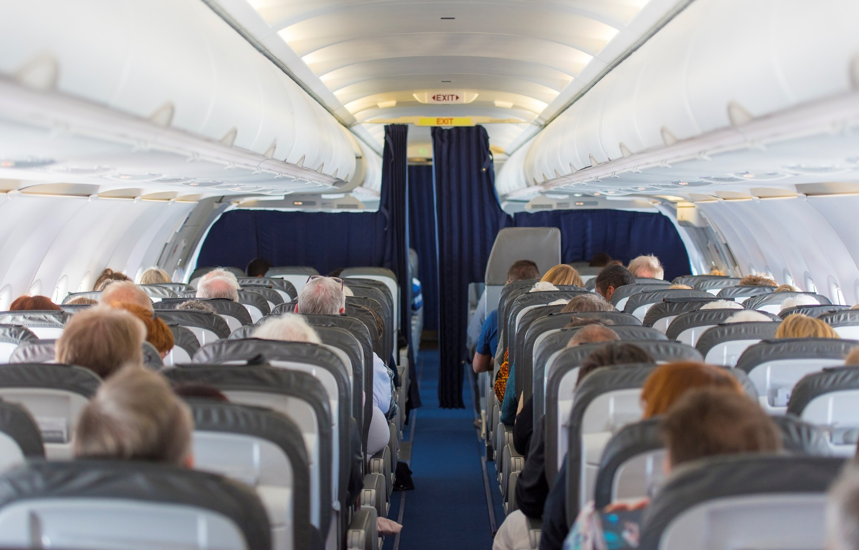
2) Explore our biases
Howard Ross’s experience
“One only sees what one looks for. One only looks for what one knows.”
Goethe
Notes:
2 ½ minute video (can start a few seconds in) of Howard Ross telling his story about implicit bias; https://www.youtube.com/watch?v=KVp9xCmDqPs
First a Howard Ross example; then some examples from my life; then small group breakouts to discuss.
Ask group to start thinking about things in their experiences, culture(s), & context(s) that might influence their own biases.

Slide 17
Explore our biases
Experiences
Culture
Context
Brian Crane, Pickles © 3/27/2019, Permission of Universal Uclick
Notes:
Ask group to start thinking about things in their experiences, culture(s), & context(s) that might influence their own biases.

Slide 18
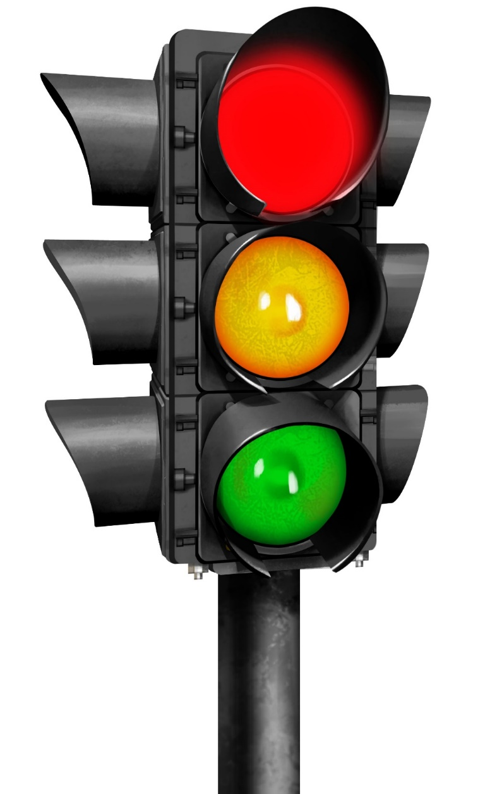
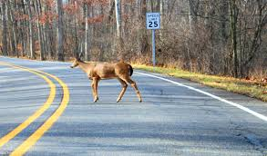
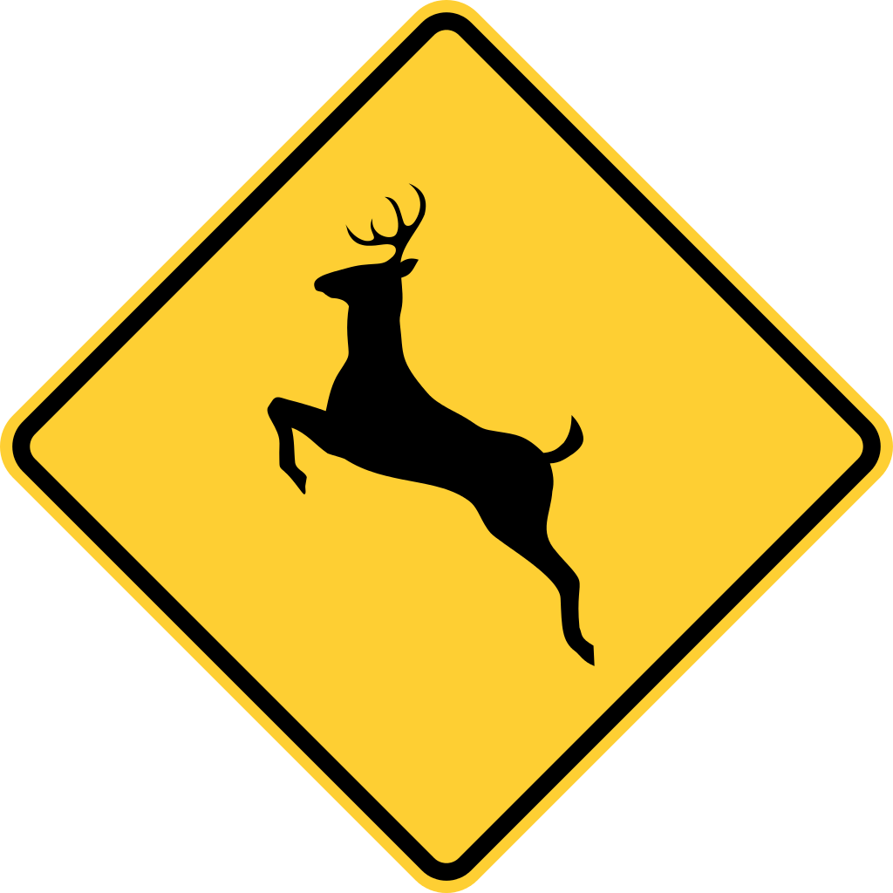
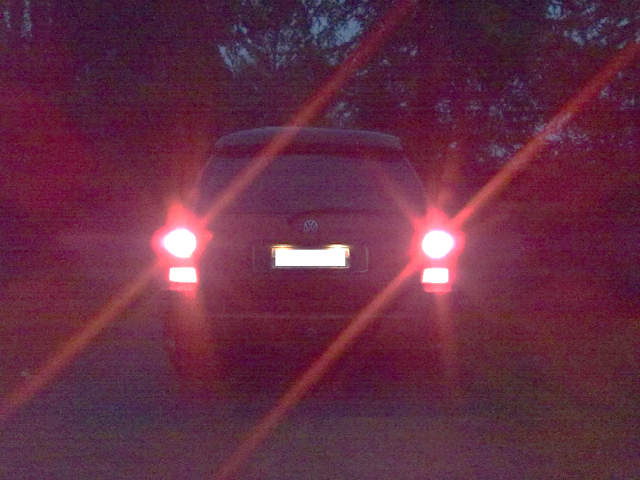
My experiences with driving
All images permission via Wikimedia Commons
Notes:
All the above induce automatic reactions to experienced drivers if familiar with them. Example of unconscious biases being helpful in keeping us safe.

Slide 19
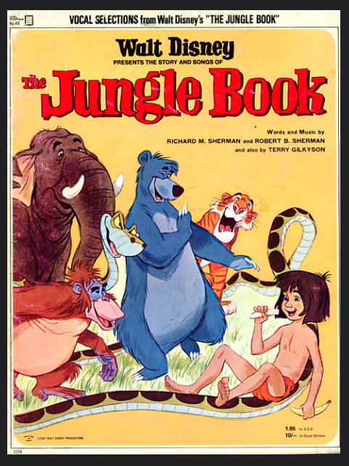
My experiences with snakes
Permission via Rossano aka Bud Care flickr
Permission via Public domain work of art
Notes:
Bible, Jungle Book, Snakes on a Plane – all shaped my feelings about snakes.

Slide 20
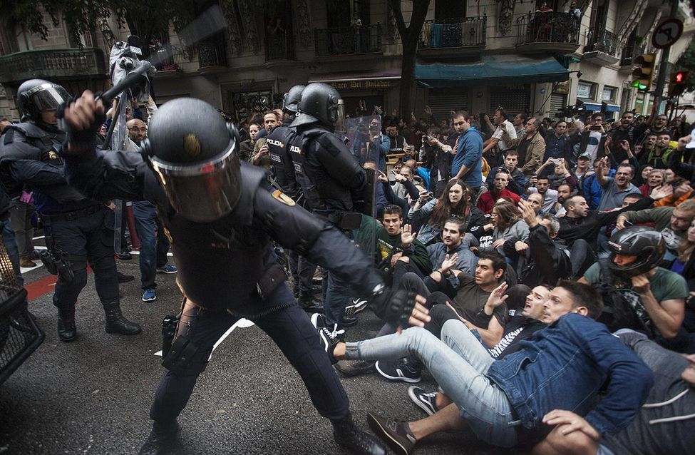
“Viewers of crime dramas are more likely to believe the police are successful at lowering crime, use force only when necessary, and that misconduct does not typically lead to false confessions”
Donovan, K. M., & Klahm IV, C. F. (2015). The role of entertainment media in perceptions of police use of force. Criminal Justice and Behavior, 42(12), 1261-1281.
Notes:
Donovan, K. M., & Klahm IV, C. F. (2015). The role of entertainment media in perceptions of police use of force. Criminal Justice and Behavior, 42(12), 1261-1281.

Slide 21
Age - stereotype
© Speed Bump by Dave Coverly; 7/3/2022
Notes:
Because I read comics a lot, I’ll use a few examples of stereotypes perpetuated in comics.

Slide 22
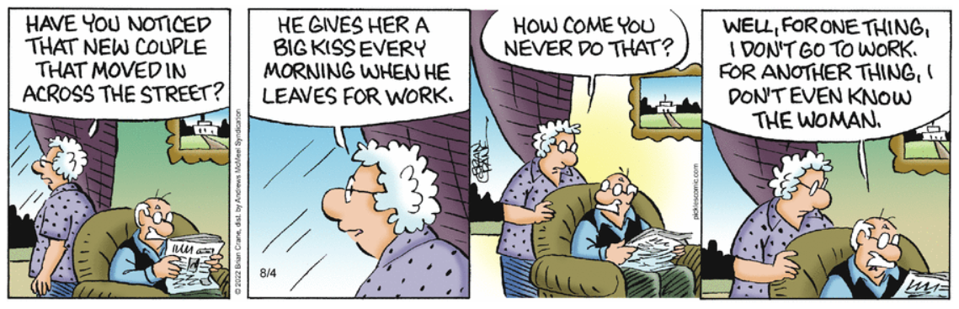
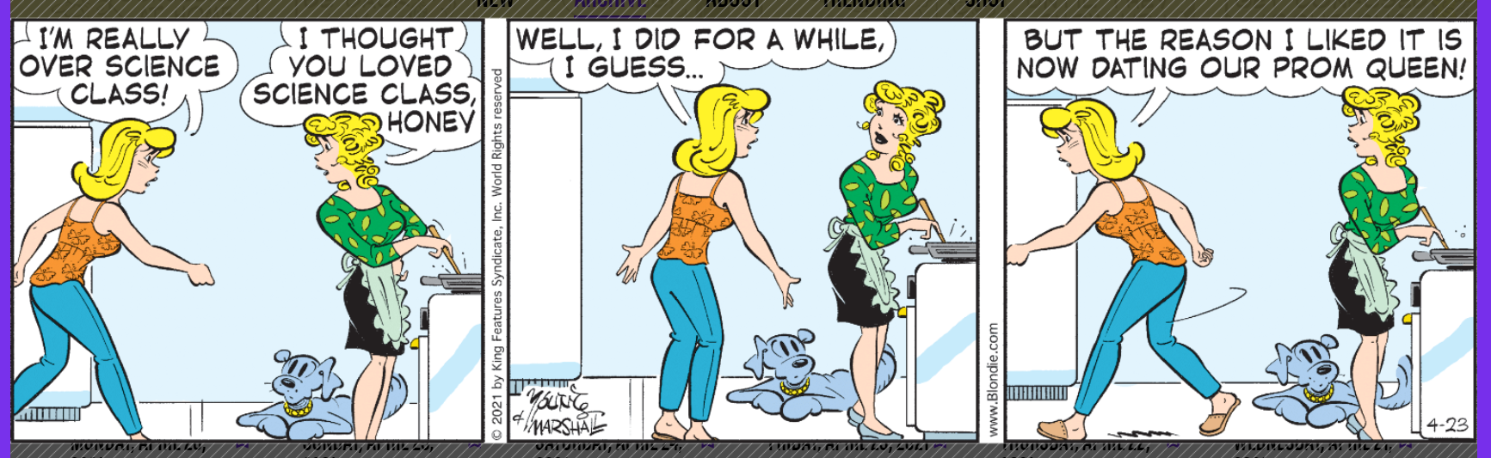
Gender representations – stereotypes
Pickles © 6/11/2021; 8/4/2022, Brian Crane
Blondie © 6/11/2021; 4/23/2021, Permission of Universal Uclick
Notes:
Ask if they can identify what stereotype is being perpetuated in each comic.
Personal example to share. At Lesbihonest Fringe play, Saskatoon, 2022, Laura Piccinin discussed the awkwardness of being on a date with another woman when you both use the bathroom at the same time (“are we still on a date in here? Which stall do I pick? Close to her or far away?”). In my heteronormative world, I never considered that dating dynamic.

Slide 23
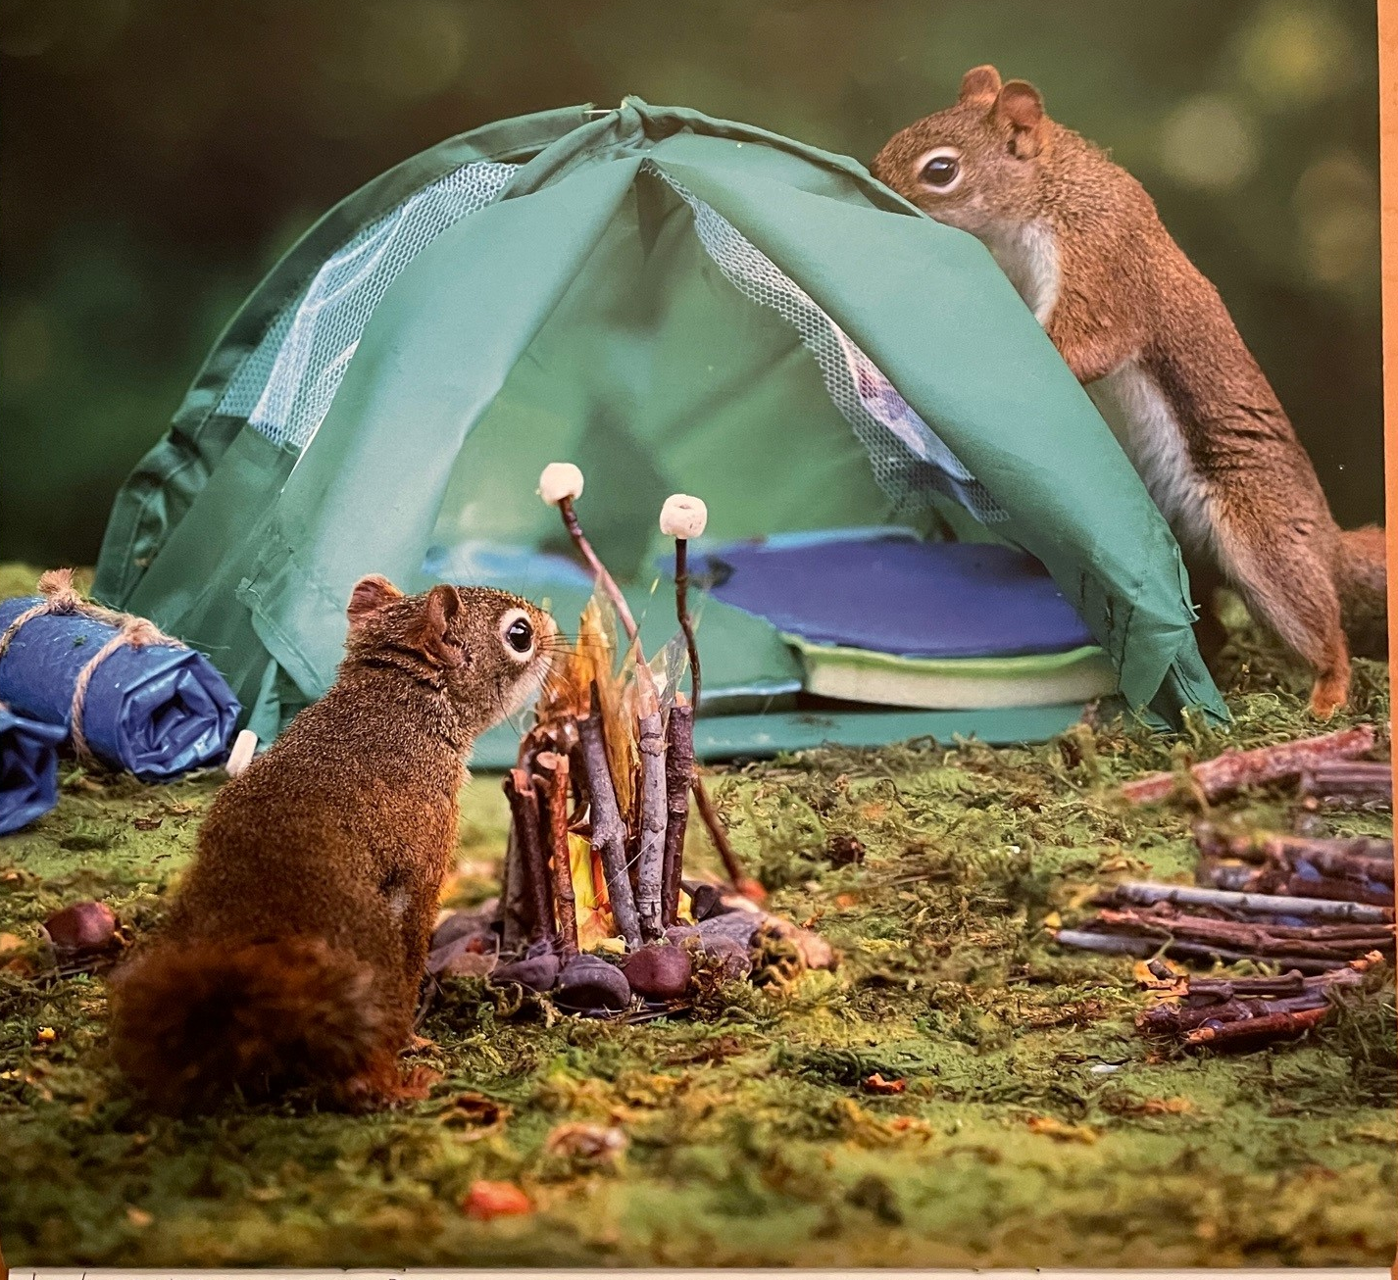
Stereotype(s) perpetuated?
© 2021 Nancy Rose Photography
Notes:
My cutest example of gender stereotypes – squirrel calendar photo from September 2022.
On the lighter side, at least he’s not “Professor” or “Doctor” Peanut. & she’s not Mrs. Peanut.

Slide 24
Culture
Notes:
Handshake as greeting is a common (pre-COVID) Western cultural expectation. Remember a bias is an association.
Other common Western cultural biases are around importance of time & written history.
Personal example: When the Pope visited in Canada in 2022 to apologize for harms to Indigenous people, among many things that many people were unhappy with, one that I hadn’t considered – Catholics believe in apologies & forgiveness as a standard way of correcting a wrong. I grew up Catholic & had this same assumption – not considering that some cultures may have very different belief systems (& in fact do of course).
For a full description of this, see “Sometimes, the word sorry is not enough”, Allison Hanes, Montreal. https://montrealgazette.com/opinion/columnists/allison-hanes-sometimes-the-word-sorry-is-not-enough.
Some languages have no word for “sorry”. Acts of repentance needs to produce a tangible act in order for an apology of value. To some, the Pope’s apology was “one-sided, is offered on the ‘perpetrators’’ terms, puts the onus on Indigenous people to heal & is rooted in the Catholic doctrine of granting forgiveness when requested.” Wahehshon Whitebean (Mohawk) said “in our language, we do not have a word for sorry … culturally, we’re taught we have to make our wrongs right. You have to do everything in your power to make everything right when there’s a wrong.” For many, words alone are insufficient to make up for these atrocities; words must be followed up with action.
Cuddy, A. J., Wolf, E. B., Glick, P., Crotty, S., Chong, J., & Norton, M. I. (2015). Men as cultural ideals: Cultural values moderate gender stereotype content. Journal of personality and social psychology, 109(4), 622. Stereotypes are not universal & are moderated by cultural values. For example, in South Korea, a highly collectivistic nation, people associate men as more communal than women – still patriarchal.

Slide 25
Family dynamics
“… refers to the patterns of interactions among relatives, their roles and relationships, and the various factors that shape their interactions.”*
Matrilineal
Multi-generational household
Traditional nuclear family
Non-traditional nuclear family
Extended family
Patrilineal
* Jabbari B, Rouster AS. Family Dynamics. [Updated 2022 Jul 25]. In: StatPearls [Internet]. Treasure Island (FL): StatPearls Publishing; 2023 Jan-. Available from: https://www.ncbi.nlm.nih.gov/books/NBK560487/
Notes:
Definition – patterns of interactions among relatives, their roles & relationships, & the various factors that shape their interactions.
Main point – different doesn’t mean better or worse.
Article about different family dynamics & the danger of making assumptions.
https://www.dimensionsofculture.com/2010/11/culture-and-family-dynamics/#:~:text=In%20western%20cultures%2C%20and%20particularly,of%20parents%20and%20their%20children.

Slide 26
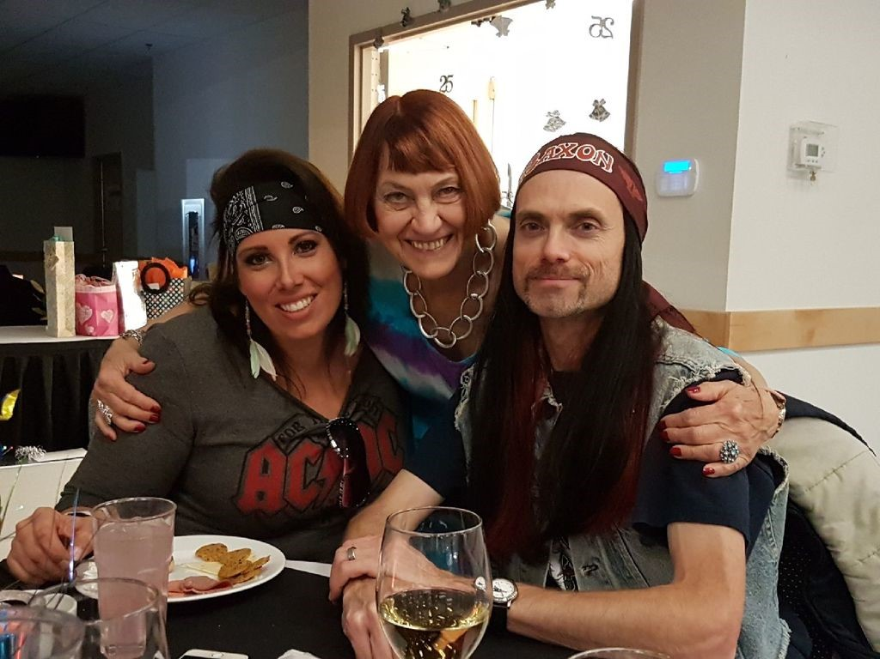
80s Rock subculture
Notes:
If this looks cool to you …
Subcultures can be based on any number of things like music, hobbies, religion, ethnicity, sports, theatre, etc.

Slide 27
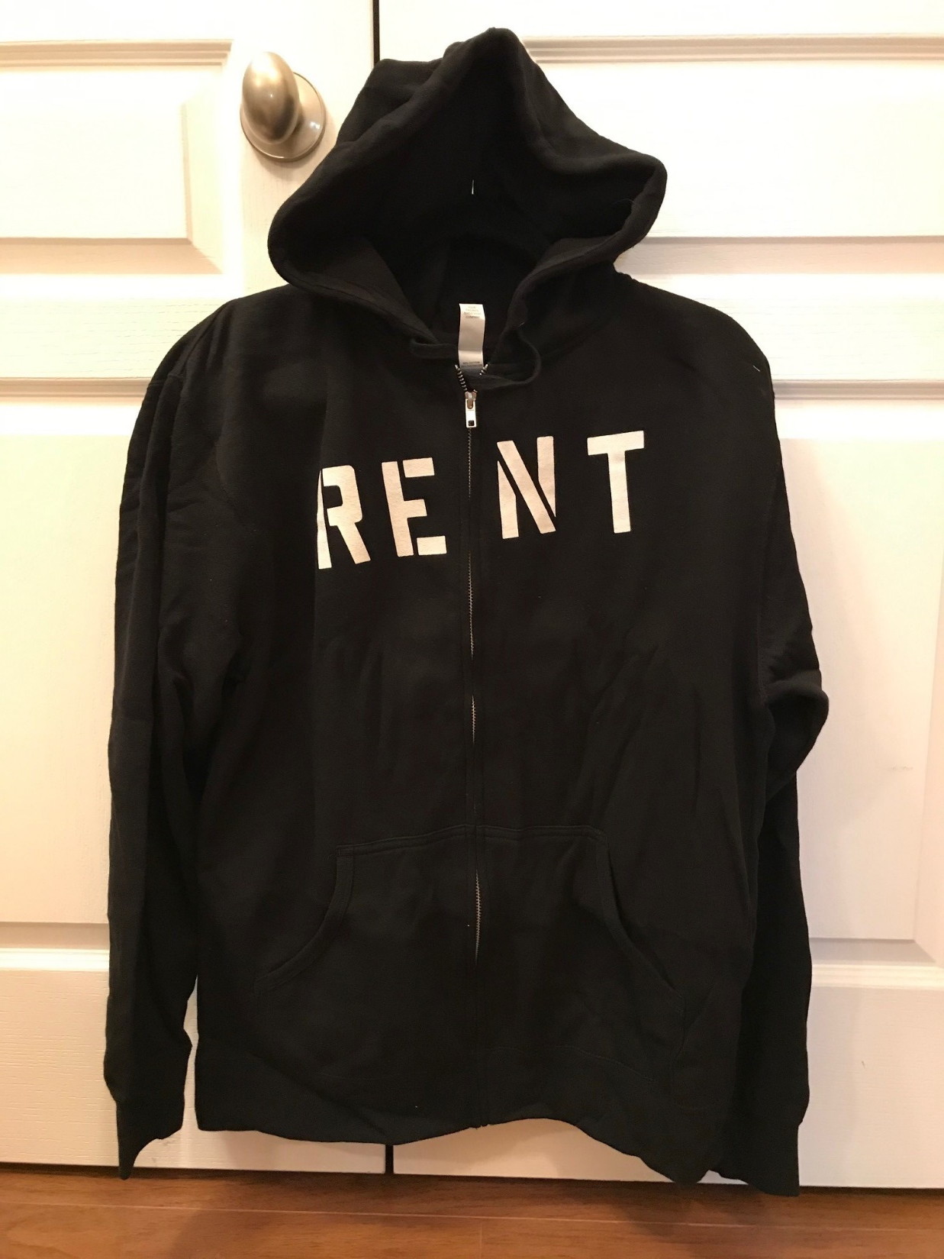
Hoodie?
Or bunny hug?
Notes:
Food, language, clothing, customs, etc. that differ among cultural groups. Broad (ex: Western or Eastern) or sub cultures (ex; music, hobby, etc.)

Slide 28
Would you answer the door at midnight …
How about late afternoon on Halloween?
Context!

Slide 29
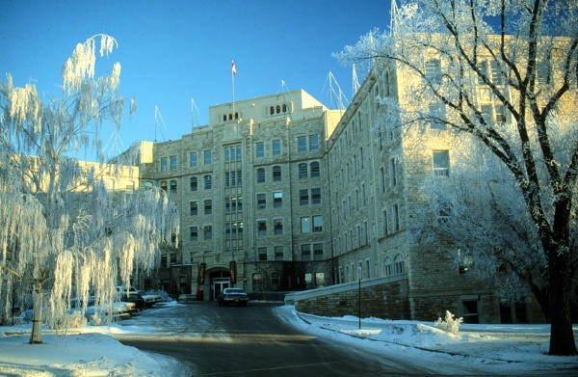
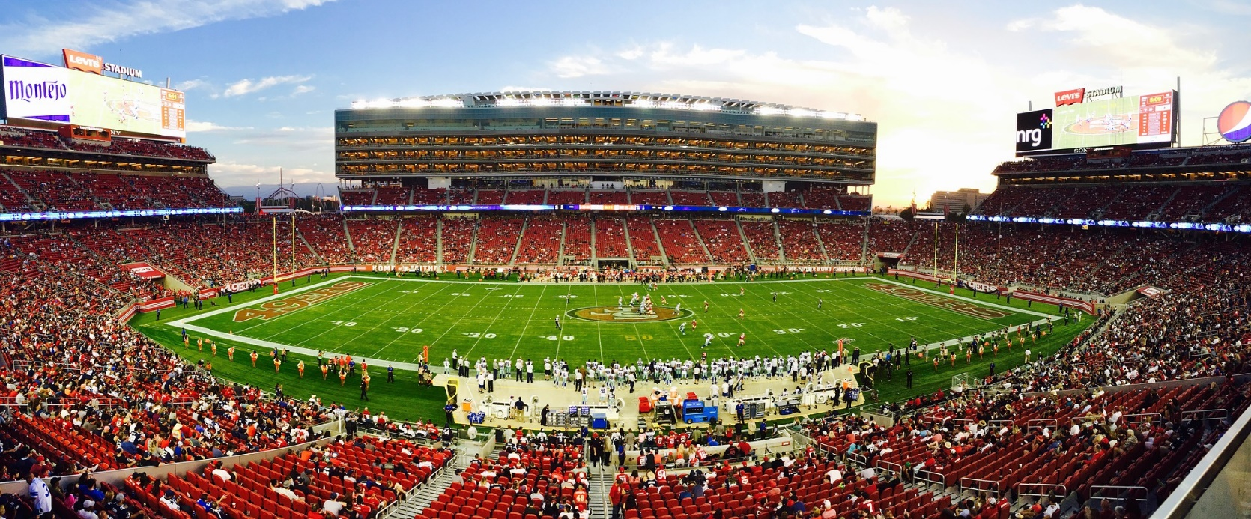
Football stadium vs. hospital
Image courtesy pixabay
Notes:
Could show this short video clip for humour - another example of context. Start at 12 seconds – it’s about a minute long. Shows what happens when football culture & office culture mix.
Office Linebacker Terry Tate Funniest Superbowl Commercial; https://www.youtube.com/watch?v=LrzvcsjJIG4

Slide 30
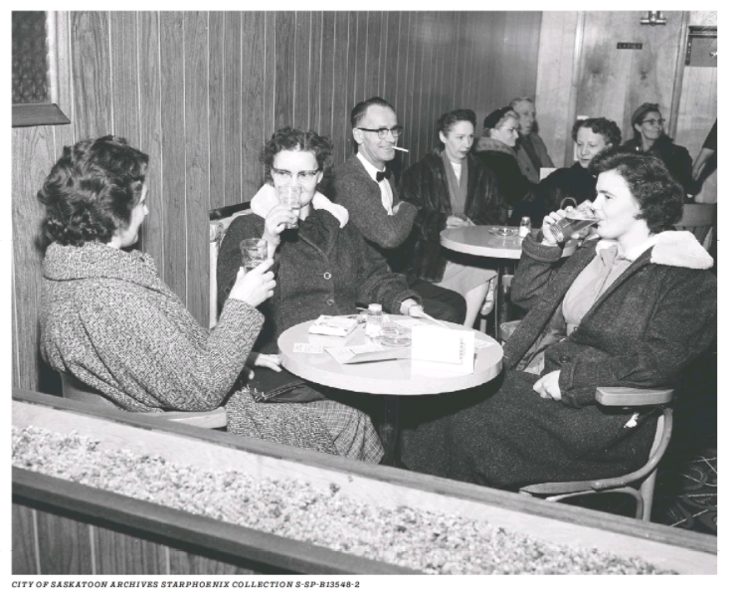
Jan. 6, 1960
Sutherland Hotel
© Saskatoon StarPhoenix; January 6, 2022
Significance?
Notes:
New example of context - & also culture & experience.
Saskatoon’s 1st men’s & women’s licensed beverage room – 1st time women could drink in a Saskatoon bar.
“On April 1, 1959, the Liquor Licensing Act was passed by the provincial legislature. It established a process of local options votes whereby licensed dining rooms, cocktail bars and beverage rooms could be established in Saskatchewan communities. Women were allowed into these new liquor outlets.”
“On May 25, 1972 the Warman Hotel and the Marchwell Hotel were the last two beer parlours in Saskatchewan that did not allow women to drink in their premises. Residents had consistently voted against mixed drinking in local option votes. Amendments to provincial liquor laws in 1972 changed the status of beer parlours and Vic Lynn, proprietor of the Warman Hotel, could finally take down the “Men Only” sign.”
https://www.sasktoday.ca/north/opinion/ladies-and-escorts-women-allowed-in-bars-in-the-1960s-4126158

Slide 31
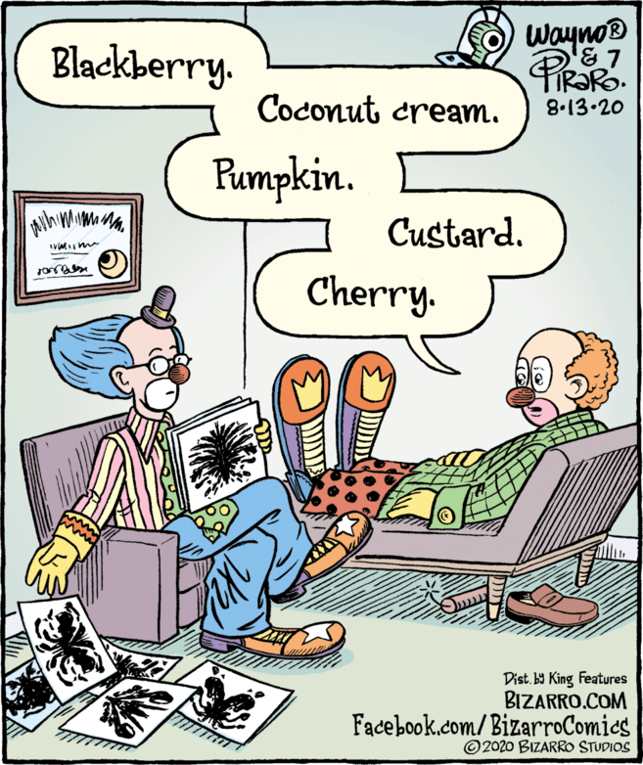
Clown experience, culture, & context
©
Notes:
This “pie bias” may come from any or all 3 of our categories.
A lighter study to illustrate unconscious bias’s influence of in-store music on wine selection. When French music was played, more French wine was purchased. When German music, more German wine. 2 week study, music alternated day to day. Customers were unaware of the effect.

Slide 32
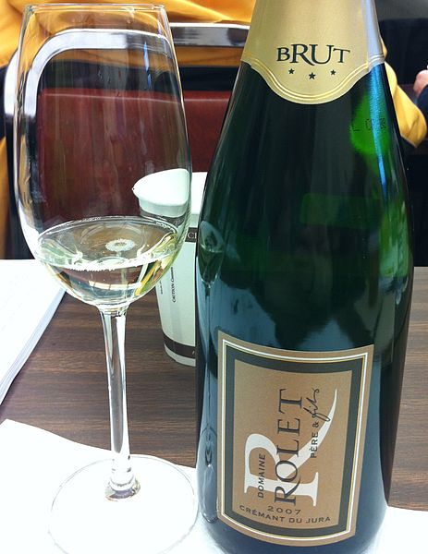
Unconscious bias & wine purchase
Courtesy Wikimedia Commons
Notes:
A lighter study to illustrate unconscious bias’s influence of in-store music on wine selection. When French music was played, more French wine was purchased. When German music, more German wine. About ¾ of customers bought the wine from the same country as the music. 2-week study, music alternated day to day. Customers were unaware of the effect.
North, A. C., Hargreaves, D. J., & McKendrick, J. (1999). The influence of in-store music on wine selections. Journal of Applied psychology, 84(2), 271.

Slide 33
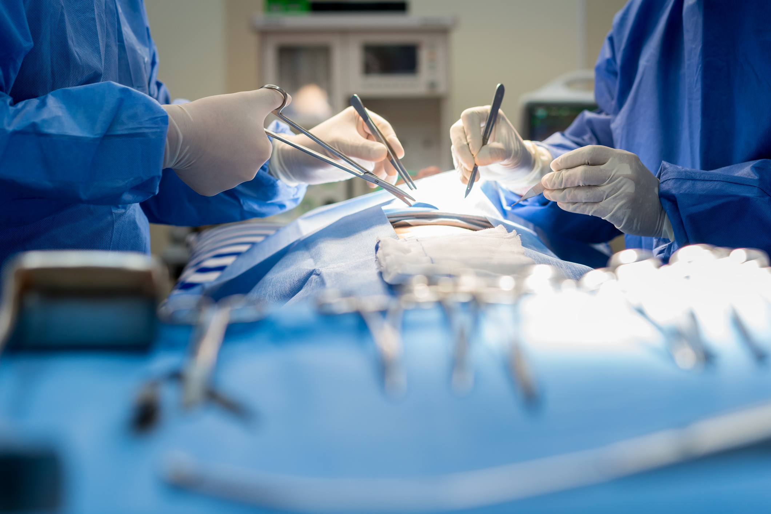
Surgeon riddle
There’s a man and his son in a car crash. The father is killed & the son rushed to hospital. The duty surgeon says: ‘I can’t operate; that boy is my son!’
Belle, D., Tartarilla, A. B., Wapman, M., Schlieber, M., & Mercurio, A. E. (2021). “I Can’t Operate, that Boy Is my Son!”: Gender Schemas and a Classic Riddle. Sex Roles, 1-11.
Notes:
Reference the old riddle - a father and son are in a horrible car crash that kills the dad. The son is rushed to the hospital; just as he’s about to go under the knife, the surgeon says, “I can’t operate—that boy is my son!” Explain.
Share Dr. Nassrein Hussein’s experience (if she consents) – she told her husband & son the riddle & “the best they could come up with is that the child had 2 dads”.
Belle, D., Tartarilla, A. B., Wapman, M., Schlieber, M., & Mercurio, A. E. (2021). “I Can’t Operate, that Boy Is my Son!”: Gender Schemas and a Classic Riddle. Sex Roles, 1-11.
“Having an employed mother or female physicians, identifying as a feminist or a political liberal, and reporting low levels of sexism did not predict the realization that the surgeon in the riddle could be a woman. Only identifying as female predicted a greater likelihood of this response. Only 30% of participants were able to transcend stereotyped gender schemas and realize that a surgeon could be a woman and a mother. Explicitly expressed egalitarian beliefs do not guarantee objective, accurate perceptions and treatment of others. Rather, our perceptions of others are strongly influenced by the nonconscious beliefs we all hold about gender differences. Considering the increased prevalence of female surgeons, both in real life and in media representations, the difficulty many of the study’s participants had in envisioning a female surgeon illuminates the inertia of powerful and pervasive gender schemas. To remember the riddle yet forget its solution (1/3 of participants remembered hearing the riddle before) suggests again how deep such gender schemas lie. Although the high number of responses suggesting same-sex parents as a solution to the riddle may indicate plasticity in schemas in response to changes in the socio-political climate, it also highlights by contrast the resistant nature of gender schemas. The current results suggest that gender schemas continue to influence problem-solving, despite one’s personal beliefs, values, or life experiences.”

Slide 34
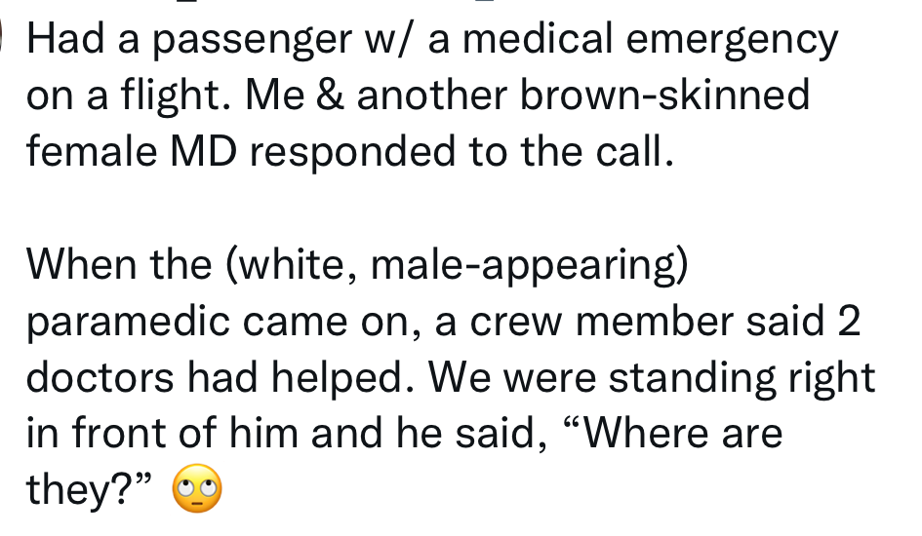
What does a doctor look like?
Notes:
Twitter thread from August 2022 – doctors discussing assumptions about their competence/qualifications based on appearance. Real life examples of the “surgeon riddle”.
Could use for affect heuristic or microaggressions too.

Slide 35
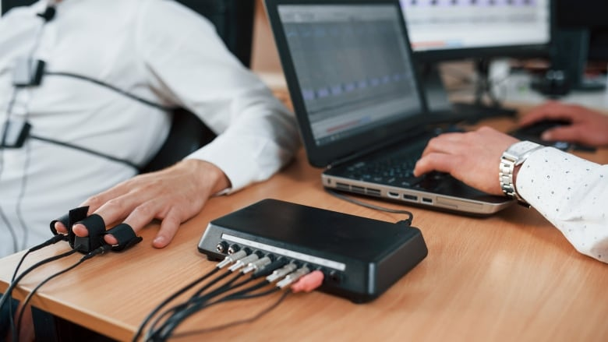
Polygraph problems
Photo courtesy https://www.cbc.ca/news/politics/polygraph-test-nsira-cse-1.6512569
Notes:
Ask – how do polygraph (lie detector) tests work?
Ask – why are they unreliable?
People use some of the same indicators to discern honesty. A rudimentary search showed polygraphs correct 80-90% of the time; people 50-60%.
Some false positives & some false negatives are inevitable. Some who lie will not have the physiological symptoms the test (or people) looks for & some people who tell the truth will display the physiological signs for other reasons. New AI (facial & eyes) & fMRIs might be more reliable but still not 100%.
Consider gender, age, ethnicity, culture, etc. will all be factors that play out differently with each individual person.
Most (all) biases are based on limited amounts of information (& sometimes incorrect information).

Slide 36
Striving for fairness
Milkman, K. L., Akinola, M., & Chugh, D. (2015). What happens before? A field experiment exploring how pay and representation differentially shape bias on the pathway into organizations. Journal of Applied Psychology, 100(6), 1678.
Notes:
A name can activate a bias. Professors were emailed by fictional prospective students seeking to discuss research opportunities. Message was identical but the gender & race of the students varied. Significantly more responsive to Caucasian males than others. Lots of similar studies with resumes & such.
Moss-Racusin, C. A., Dovidio, J. F., Brescoll, V. L., Graham, M. J., & Handelsman, J. (2012). Science faculty’s subtle gender biases favor male students. Proceedings of the national academy of sciences, 109(41), 16474-16479. One of the first studies of its kind – sent student applications/resumes to science faculty in research Universities. Same letter but one from John & one from Jennifer. Gender bias shown in terms of competency, hireability, willingness to mentor, & starting salary. The bias was evident regardless of faculty gender.

Slide 37
Pair discussion
Reflect on some personal examples
What has influenced how you see the world?
Impact:
Diagnosis/treatment decisions
Interactions with patients/colleagues
Experiences
Real life, movies, books, games, media, education, etc.
Culture
Broad & sub-culture groups (ex: urban/rural)
Identities (ex: music, hobbies, beliefs, etc.)
Context
Place & time (ex: sports field, hospital, etc.)
Notes:
Send the document with this screen shot in advance & put in the chat before sending them to breakout sessions.
Can do this in pairs or in group of 3.
See if anyone wants to share time permitting.

Slide 38
3) When is it most important/likely?
Strong emotional or physical reaction
New &/or unique conditions
Importance or complexity
Fear, anxiety, uncertainty
Stressed, rushed, tired
Notes:
Warning signs to slow down & consider bias. Situational awareness.
Our brains use shortcuts to preserve energy so bias is more likely when we are tired, stressed, rushed, or excited.
Bias is more likely to manifest with clinical uncertainty, heavy workload, fatigue, & time pressure. So anything that can be done to reduce things like stress & burnout will be beneficial.
Eva, K. W., Reiter, H. I., Rosenfeld, J., & Norman, G. R. (2004). The relationship between interviewers’ characteristics and ratings assigned during a multiple mini-interview. Academic Medicine, 79(6), 602-609.
DeSteno D, Dasgupta N, Bartlett MY, Cajdric A. Prejudice from thin air: the effect of emotion on automatic intergroup attitudes. Psychol Sci. 2004;15(5):319-324.
Dasgupta N, DeSteno D, Williams LA, Hunsinger M. Fanning the flames of prejudice: the influence of specific incidental emotions on implicit prejudice. Emotion. 2009;9(4):585-591.
Dyrbye L, Herrin J, West C, Wittlin N, Dovidio J, Hardeman R, et al. Association of racial bias with burnout among resident physicians. JAMA Netw Open. 2019;2(7):197457.
Johnson TJ, Hickey RW, Switzer GE, et al. The impact of cognitive stressors in the emergency department on physician implicit racial bias. Acad Emerg Med. 2016;23(3):297–305.

Slide 39
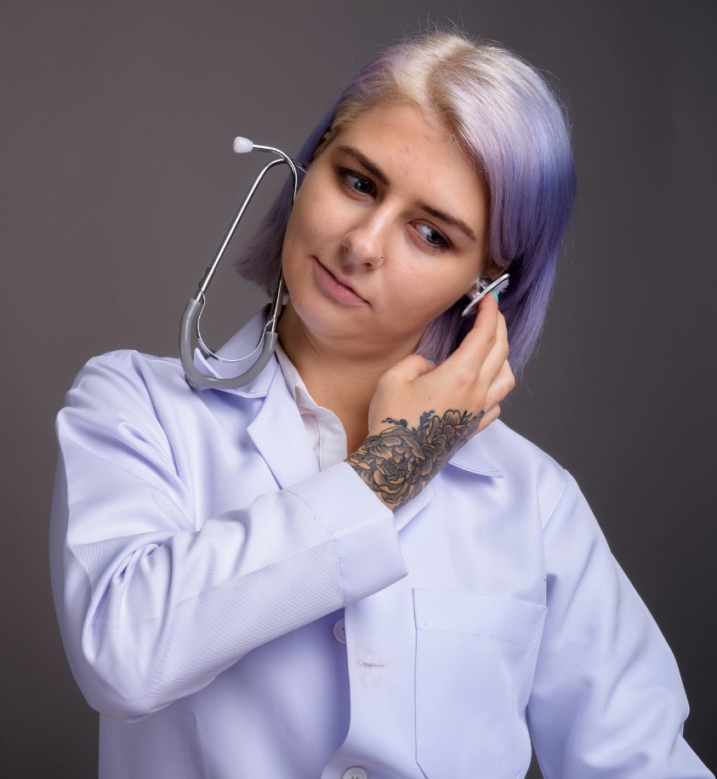
Acknowledgement, acceptance, & awareness
Interrupt from directly influencing our decisions & behaviours
Mitigation not elimination
Notes:
All about disruption – not elimination.
Important to note that our biology makes unconscious biases inevitable but they have socio-cultural sources (i.e. they are learned) which means we can address them & alter our actions.
Awareness involves self-audit (who are my friends & contacts; who do I think of when someone mentions, pilot, doctor, engineer, etc.?)
Acceptance means not denying that we have these biases.

Slide 40
Take an Implicit Association Test
Capers IV, Q., Clinchot, D., McDougle, L., & Greenwald, A. G. (2017). Implicit racial bias in medical school admissions. Academic Medicine, 92(3), 365-369
Notes:
Awareness alone can help mitigate a bias. Involves self-audit (who are my friends & contacts; who do I think of when someone mentions, pilot, doctor, engineer, etc.?). What are my biases?
Acceptance means not denying that we have these biases.
Harvard IAT - https://implicit.harvard.edu/implicit/canada/takeatest.html
Flower-Insect Test - https://implicit.harvard.edu/implicit/user/agg/blindspot/indexfi.htm
Note the IAT is not a measure of bias & is not indicative of intent (no need to share results). It’s an awareness raising tool to facilitate thought & discussion. It doesn’t necessarily predict actual behaviour (result of a combination of implicit attitudes & explicit decision-making), only automatic reactions.
From Capers IV, Q., Clinchot, D., McDougle, L., & Greenwald, A. G. (2017). Implicit racial bias in medical school admissions. Academic Medicine, 92(3), 365-369. Ohio State University College of Medicine.
“Following the implicit bias exercise and the subsequent admissions cycle, nearly half of the committee members reported agreement with the statement “when I interview candidates, I have my individual IAT results in mind,” and nearly a quarter reported that their knowledge of their individual IAT scores had an impact on their evaluation of candidates. While a causal relationship cannot be proven, in the admissions cycle immediately following the implicit bias exercise, the committee selected the most diverse class in the college’s history. Thus, taking the IAT can be an important exercise in self-awareness for medical school admissions committees.”
Awareness alone seems to have an impact on behaviour.
A recent (2019) study showed that an awareness of gender bias had a positive impact on promoting women by scientific evaluation committees. Committees that did not explicitly believe that women faced external barriers, promoted fewer women. Real world study United States wide in a variety of scientific fields.
Régner, I., Thinus-Blanc, C., Netter, A., Schmader, T., & Huguet, P. (2019). Committees with implicit biases promote fewer women when they do not believe gender bias exists. Nature human behaviour, 3(11), 1171-1179.

Slide 41
Deliberate thinking framework
Accept & acknowledge bias
Situational awareness
Identifying when bias is most relevant
Explore & examine the nature of the bias (assumptions)
Consider alternatives & multiple perspectives & sources
Pause & slow down
Notes:
Be humble & slow down.
Conscious mind needs to interrupt the unconscious.
Consider the opposite of what you think. Empathizing with someone (taking their perspective) decreases unconscious bias.
Also counter stereotyping –
Kollmayer, M., Pfaffel, A., Schober, B., & Brandt, L. (2018). Breaking away from the male stereotype of a specialist: gendered language affects performance in a thinking task. Frontiers in psychology, 9, 985. It is possible to counteract traditional gender and role schemas and increase success at solving the old mother-is-the-surgeon riddle by prompting research participants with counter-stereotypic ideas or gender-fair language immediately preceding presentation of the riddle.
Galinsky, A. D., & Moskowitz, G. B. (2000). Counterfactuals as behavioral primes: Priming the simulation heuristic and consideration of alternatives. Journal of Experimental Social Psychology, 36(4), 384-409.

Slide 42
Thinking framework
Accept & acknowledge bias
Situational awareness
Identifying when bias is most relevant
Explore & examine the nature of the bias (assumptions)
Consider alternatives & multiple perspectives & sources
Pause & slow down (deliberate brain)
“Between stimulus and response there is a space. In that space is our power to choose our response. In our response lies our growth and our freedom.” Viktor E. Frankl
Notes:
Conscious mind needs to interrupt the unconscious.
Awareness alone can mitigate bias – NBA referee study.
Viktor Emil Frankl (26 March 1905 – 2 September 1997) was an Austrian neurologist, psychiatrist, philosopher, author, and Holocaust survivor.

Slide 43
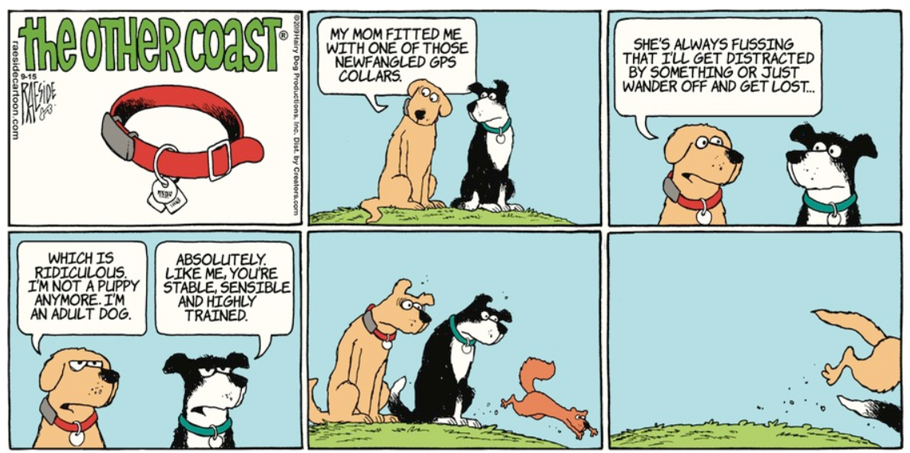
Disruption
Unconscious bias happens automatically
© The Other Coast, Adrian Raeside, 9/15/2019
Notes:
As automatic as the reaction of these dogs to a squirrel. We don’t get rid of bias.

Slide 44
Upon further inspection …
Notes:
If we had taken more time to examine the pictures earlier, we might have noticed this looks suspiciously like an insect.

Slide 45
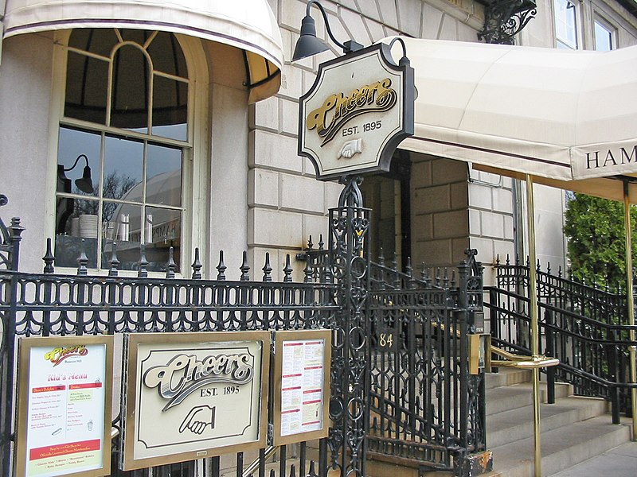
What awareness looks like
Cheers episode The Norm Who Came to Dinner
Frasier: “I wonder who invented that (machine that shakes up paint cans)? There's a guy that really made a worthwhile contribution, you know? I mean, if he was a guy. I mean, he could have been a woman, I guess. Isn't that interesting? Oh, why would I assume just right off that that would be a man?”
Unconscious bias interruption
Wikimedia Commons; Boston Cheers 2005

Slide 46
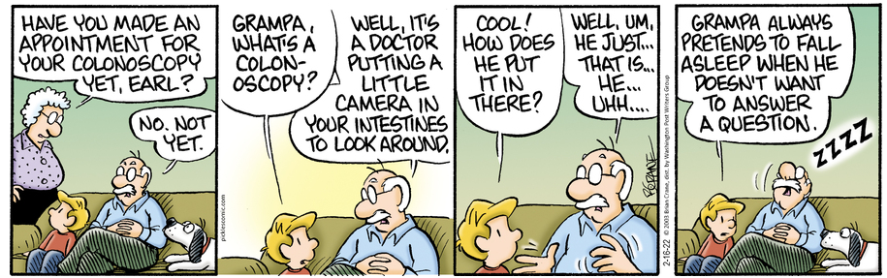
Can you spot the unconscious bias?
Brian Crane, Pickles © 2/16/2022, Permission of Universal Uclick
Notes:
Think back to the surgeon riddle … Now that we are thinking about bias, it’s easier to spot isn’t it?

Slide 47
Summary
Unconscious bias is human – normal, natural, & automatic
Bias is a product of our biology as well as our socio-cultural experiences – it helps us navigate a complex world
We can disrupt bias with a deliberate thinking framework – improve decisions
Notes:
It’s okay to talk about our biases.
Since biases are learned, they can be addressed & changed.
Need to be critical & reflective in our judgements. We use biases for efficiency & ease but we don’t want important decisions determined this way.

Slide 48
https://medicine.usask.ca/facultydev/
“Acceptance & understanding the existence of unconscious bias is a vital next step” (AAMC)

